Slide 1


DARS
UPDATES

Slide 2
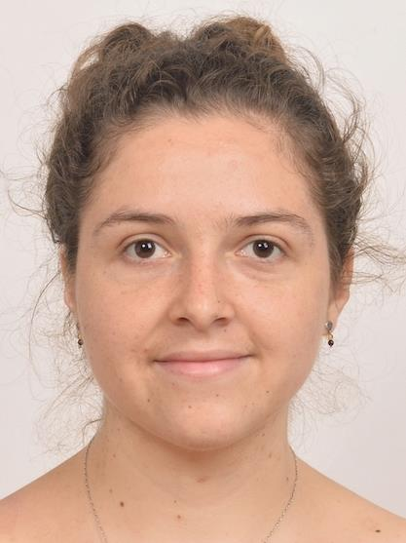
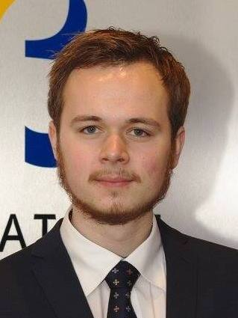

Sofia Vazquez Alferez
sofia.vazquezalferez@maastrichtuniversity.nl
Raphaël Morsomme
raphael.morsomme@maastrichtuniversity.nl

Slide 3

Content
Where we left off
What’s new
Ahead

Slide 4
1. Where we left off

Slide 5
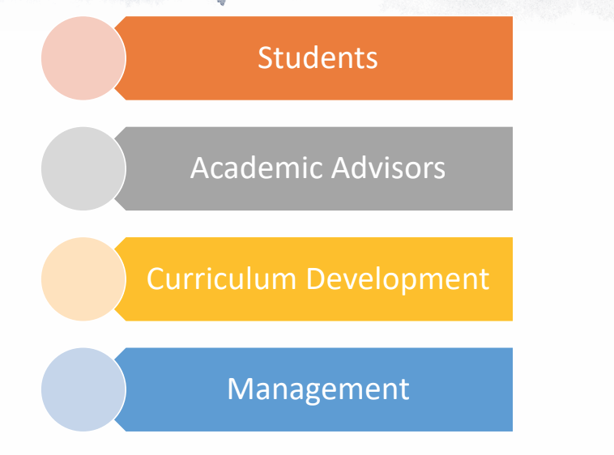
The Recommender System
Stakeholders
The System
Topic Modelling
Sequential Pattern mining

Slide 6

By Products
Where we left off

Slide 7
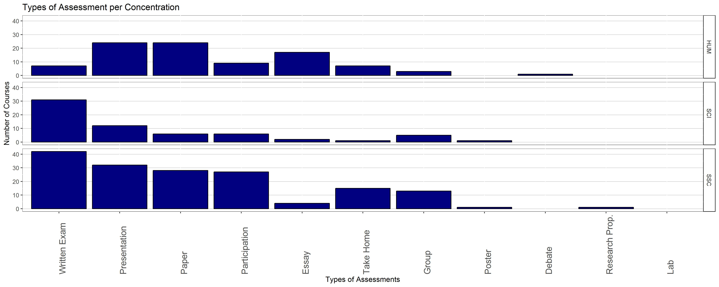
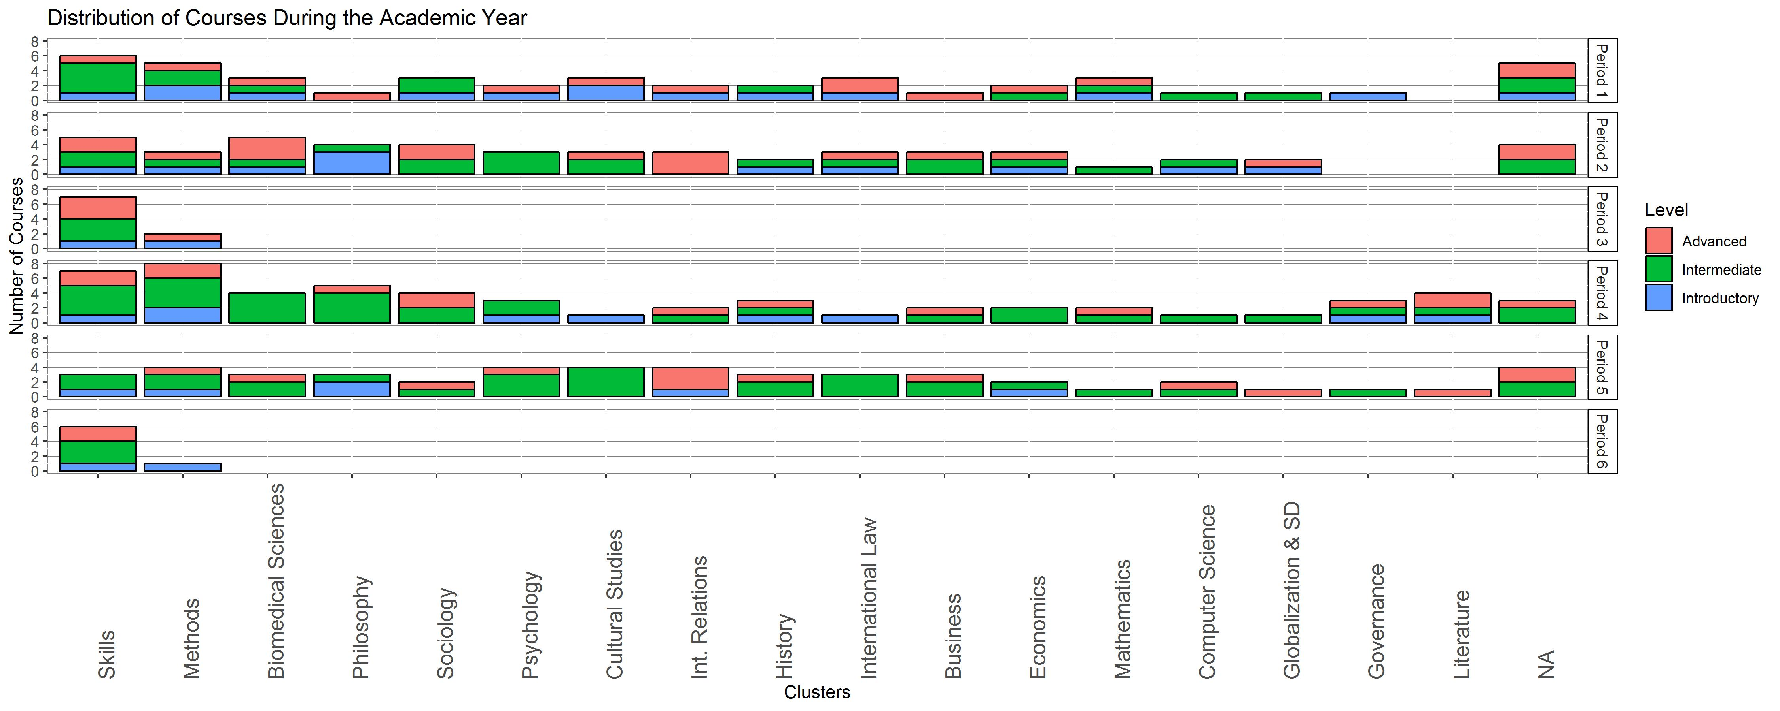

Slide 8
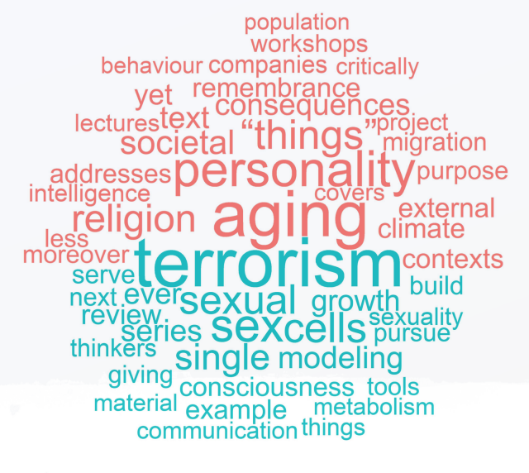
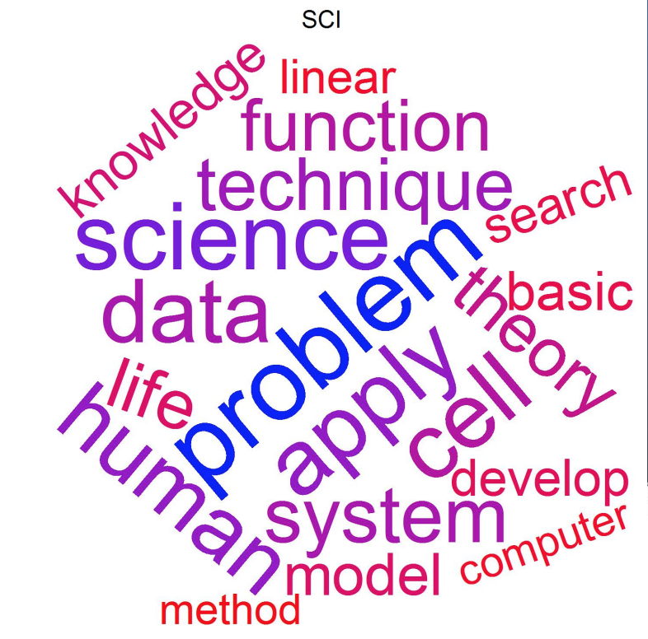
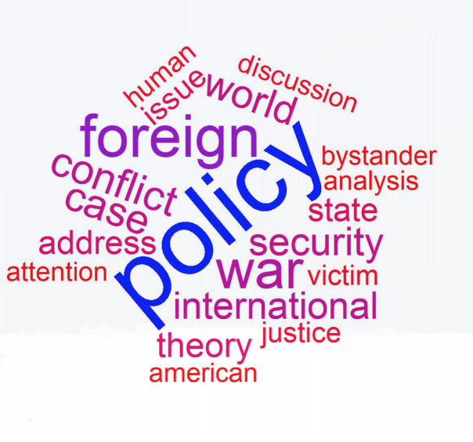
Emerging topics
Per concentration
Per course

Slide 9
2. What’s new

Slide 10
Recommender System for Students
Sequence Mining
Find common sequences of courses with outcomes (e.g. pass/fail, grades)
Topic Modeling
Model the underlying topics of all courses at UCM using LDA
APP:
Asks students for proposed curriculum and gives RedFlags
Identify RedFlags
Identify courses that share topics based on their words
Asks students for key words of interest and gives course recommendations

Slide 11
Notes:
Stated interest= key words
Current profile= curriculum so far

Slide 12
3. Ahead

Slide 13
What’s next
App for students
Override useless red flags
Provide preparatory recommendations
Make recommendations based on external material
Dashboards for management
Overview of clusters, concentrations, students’ profile
Aims, assessments, specialization of students
Notes:
Applications: recommending courses on emerging fields → text mine the curriculum and reports of IMF
Spot gaps in student profile → text mine the profile of the student and the curriculum of the faculties.

Slide 14
Thank you!
Sofia Vazquez Alferez
sofia.vazquezalferez@maastrichtuniversity.nl
Raphaël Morsomme
raphael.morsomme@maastrichtuniversity.nl

